Slide 1

Sosialisasi BINUS DAMS (Digital Asset Management System)
http://d igitalasset.binus.ac.id
Knowledge Management & Innovation - BINUS Higher Education

Slide 2
Knowledge System Team
Karto Iskandar / 1214 / karto_i@binus.edu / 0818983371
Gredion Prajena / 1214 / gprajena@binus.edu / 085694298664
Harvianto / 1214 / harvianto@binus.edu / 0817166005

Slide 3
Agenda
Background
Introduction
User
User Permission
Asset Category
Register
Sign In
Upload Content
View Content
Edit Content
Download
Embed Video
Search
Profile

Slide 4

Background
Integrate and centralize digital content in BINUS Higher Education

Slide 5
















Background
Integrate and centralize digital content in BINUS Higher Education

Slide 6
Introduction
Digital Asset Management (DAM) is a collective term applied to the process of storing, cataloguing, searching and delivering computer files (or digital assets). These may take the form of video, audio, images, print marketing collateral, office documents, fonts or 3D models.
Digital Asset Management (DAM) systems centralize assets and establish a systematic approach to ingesting assets so they can be located more easily and used appropriately
URL: https://digitalasset.binus.ac.id

Slide 7
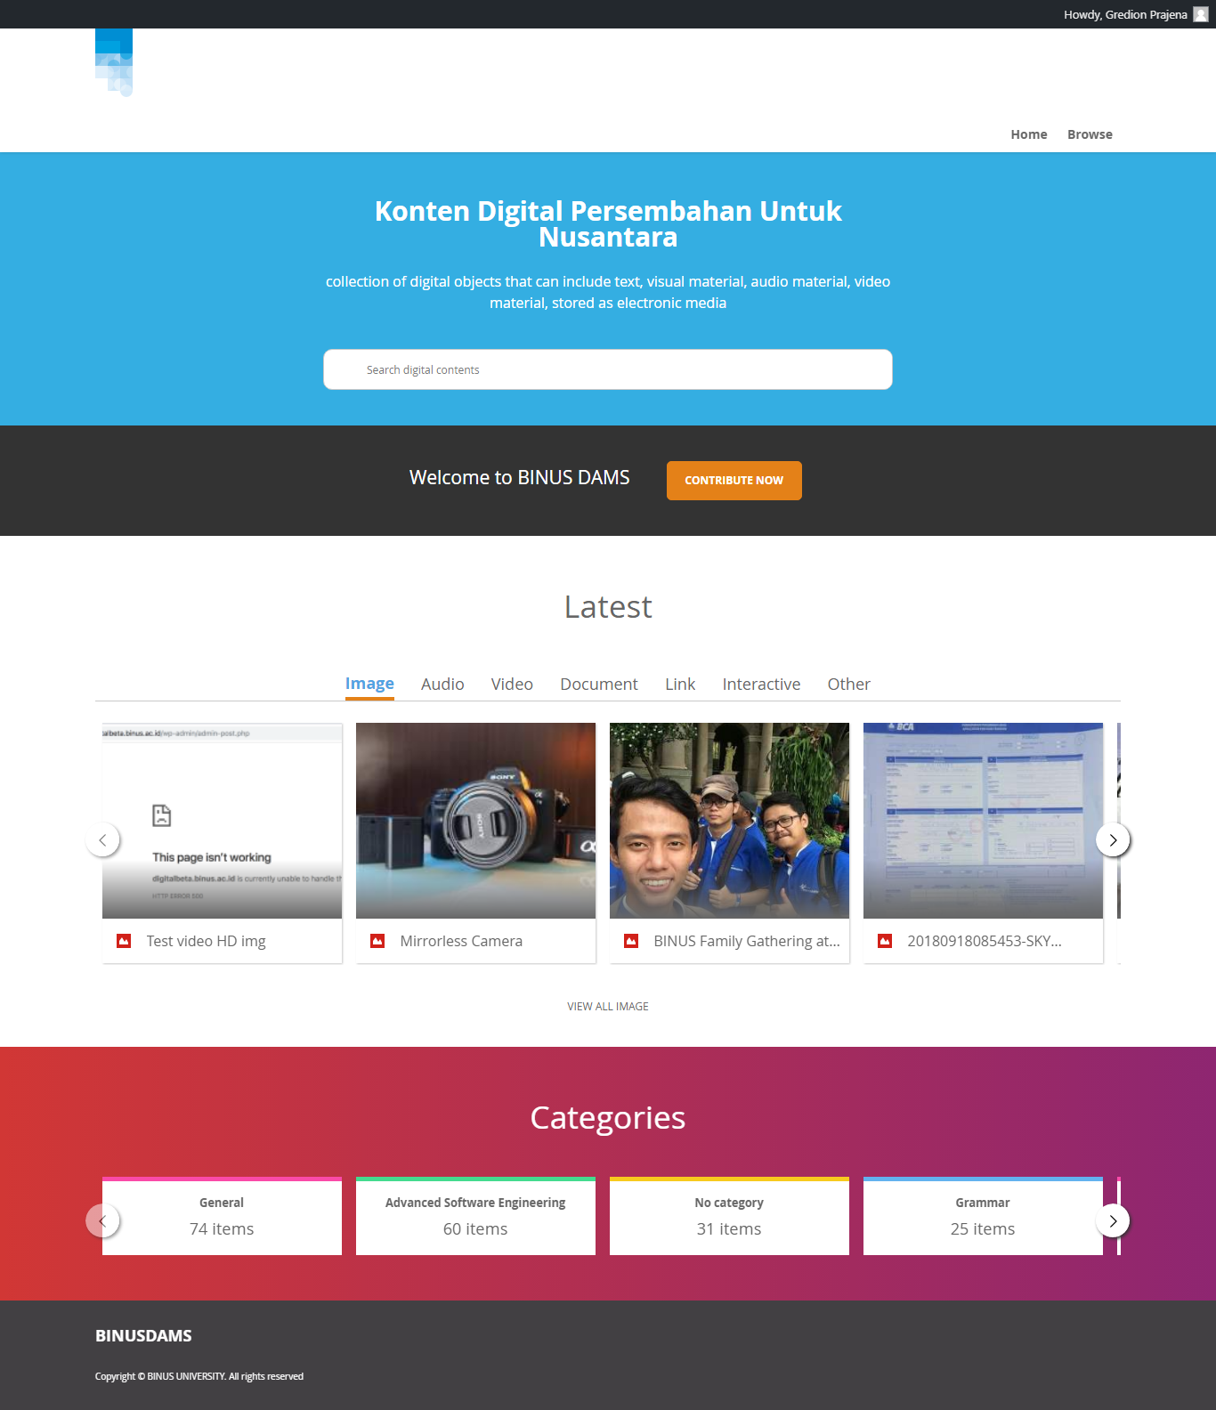

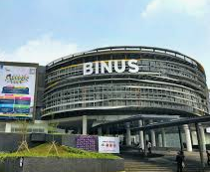
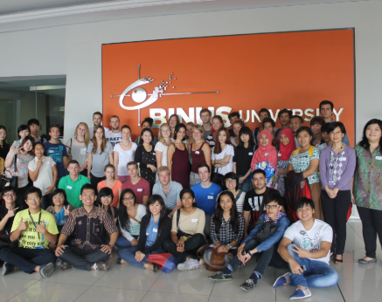
URL: https://digitalasset.binus.ac.id
Search textbox
Upload Content
Type Content
View Content
Summary

Slide 8
User
Public : Can register in BINUS DAMS
Student : Using @binus.ac.id account
Lecturer : Using @binus.ac.id account
Employee : Using @binus.edu account

Slide 9
User Permission
Permission to access digital asset determined by 4 library:
General: Can be accessed by public.
Teaching Learning: Can be accessed by employee, lecturer and student.
Lecturer: Can be accessed by employee and lecturer.
Office: Can be access by employee.

Slide 10
Asset Category
Image: jpg, png
Audio: mp3
Video: mp4
Document: ppt, pptx, doc, docx, xls, xlsx, pdf
Link: URL
Interactive: BINUS Interactive Software (BITS)
Other: Other files: zip, rar, tar, etc

Slide 11
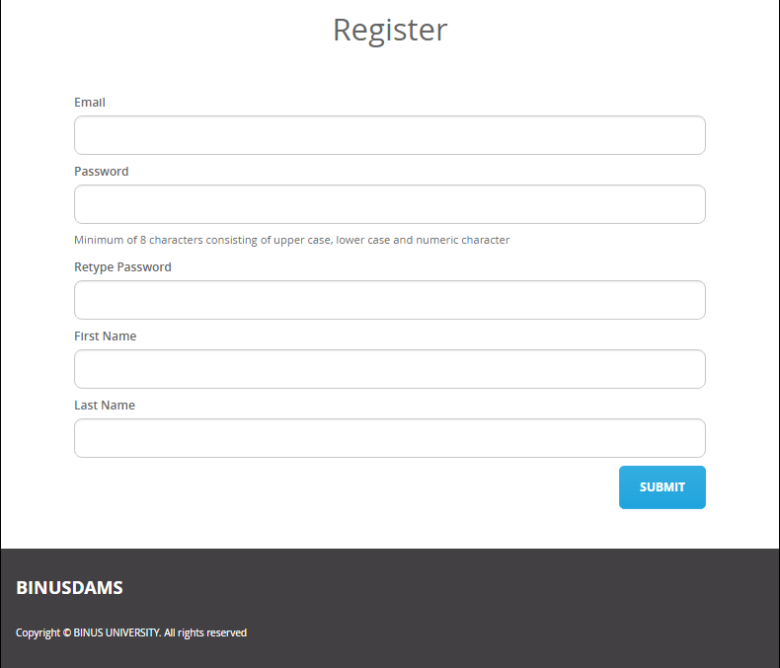
Register (1)
This is for public user, if you already have binus.edu or binus.ac.id mail, skip the registration.
Fill registration data and click SUBMIT

Slide 12
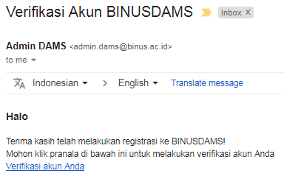
Register (2)
Verify your account by open link on your email

Slide 13
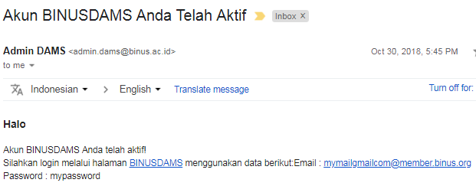
Register (3)
After verify, you’ll get activation email.
Please be noticed the username. If your email is mymail@gmail.com it will be mymailgmailcom@member.binus.org

Slide 14
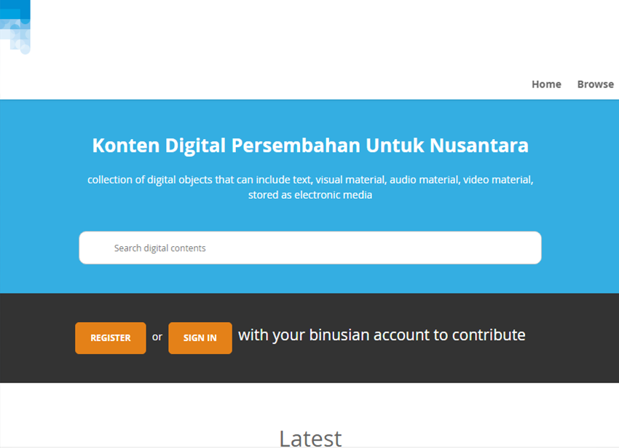
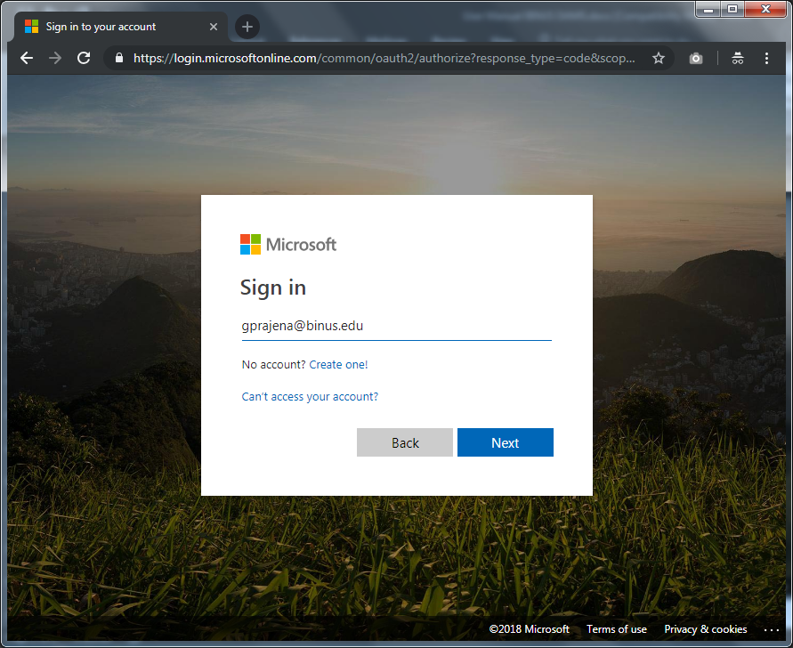
Sign In
Click SIGN IN and It will be redirect to Microsoft Login page
Follow the next step until finish

Slide 15
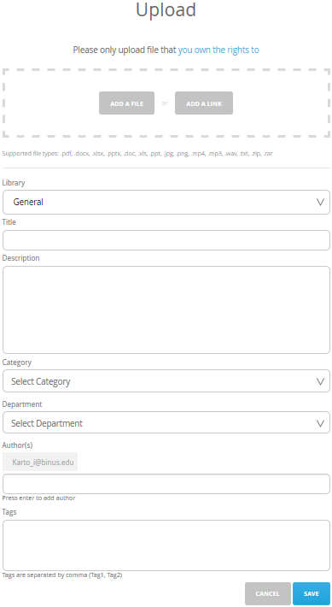
Upload Content (1)
Click “CONTRIBUTE NOW” on home page
Choose file or link by Click “ADD A FILE” or “ADD A LINK”
Choose Library
General: Can be accessed by public.
Teaching Learning: Can be accessed by employee, lecturer and student.
Lecturer: Can be accessed by employee and lecturer.
Office: Can be access by employee.
Fill Title
Fill Description
Choose Category
Choose Department / Unit
Category is group of knowledge in BINUS. You can choose general if nothing appropriate.
Add Author
Add author (if needed). You can add by typing name or email. To remove, just click the author.
Fill Tags
Fill tags to add tags to your file. Give specific and detailed tags to be searched easily (separated by comma).

Slide 16
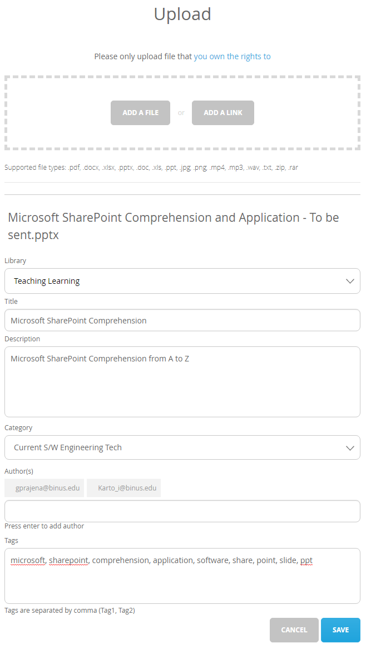
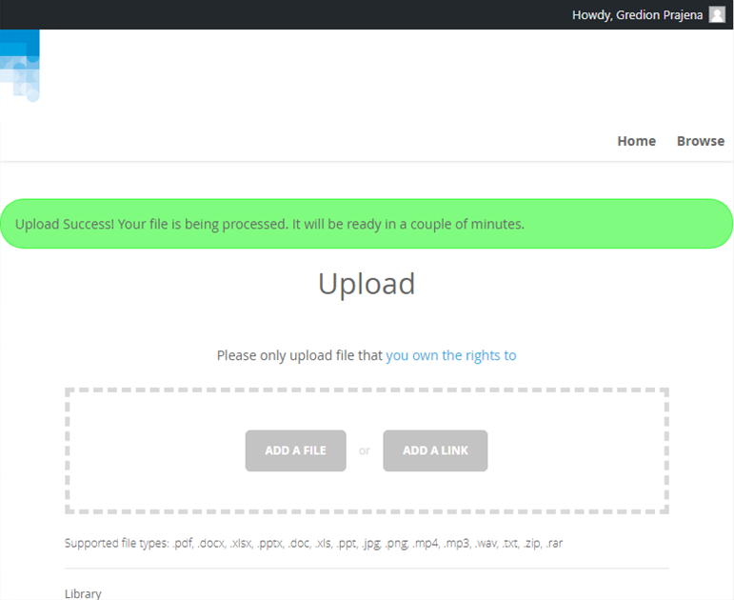
Upload Content (2)
Click Save to upload
If success, it will show upload success message

Slide 17
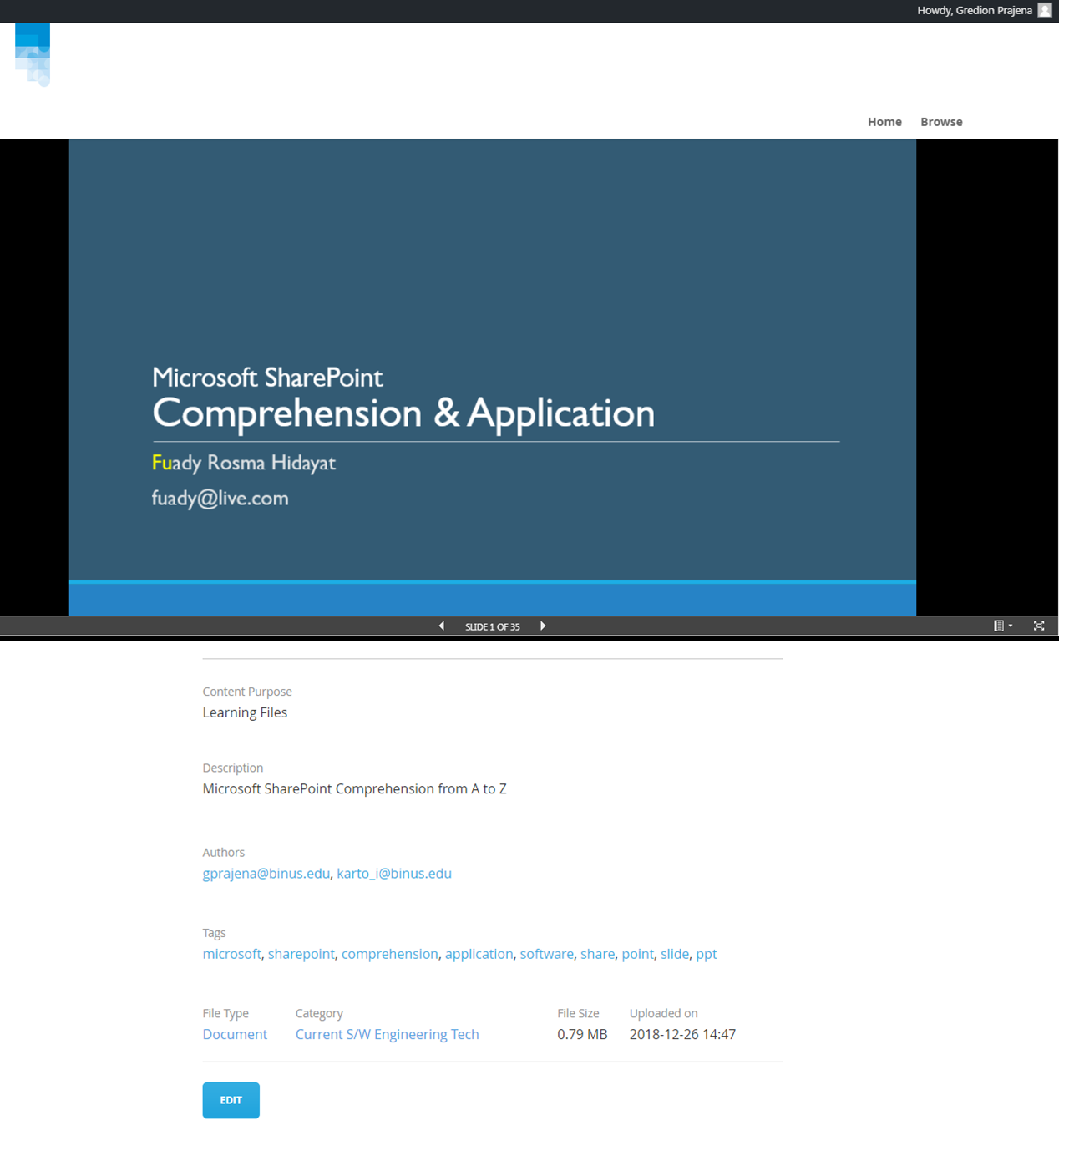
View Content
View content will vary based on asset category
Here is the example of document

Slide 18
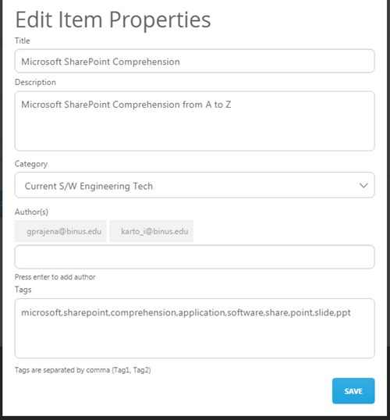
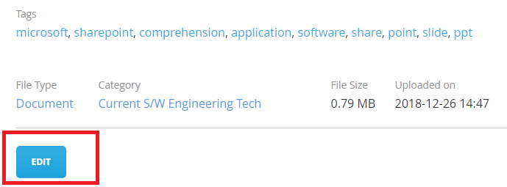
Edit Content
You can edit your file with click EDIT below on view file
Click Save

Slide 19
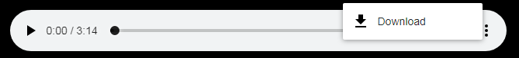
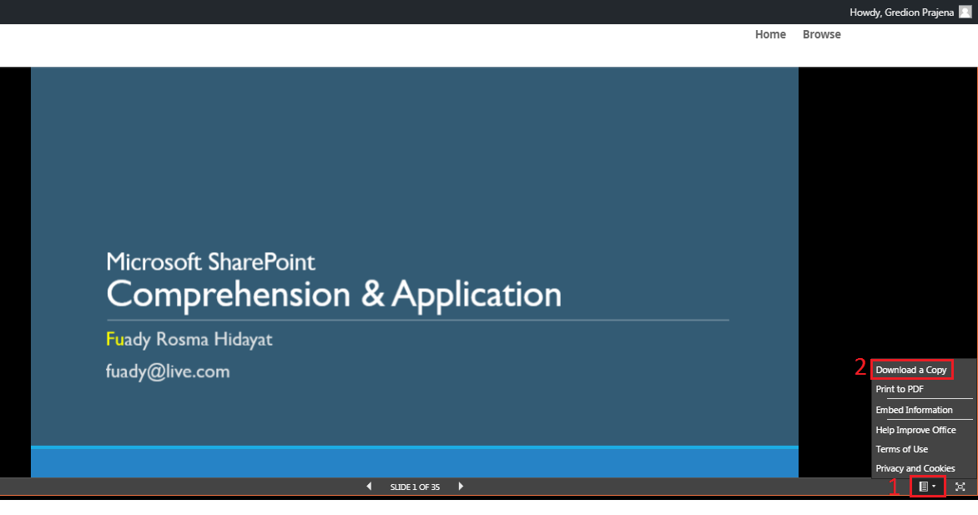
Download
Interactive & Other cannot be download
To download document file click on bottom right button and Download a Copy (see picture below)
To download audio file click on 3 dot on the right side and click Download (see picture below)

Slide 20
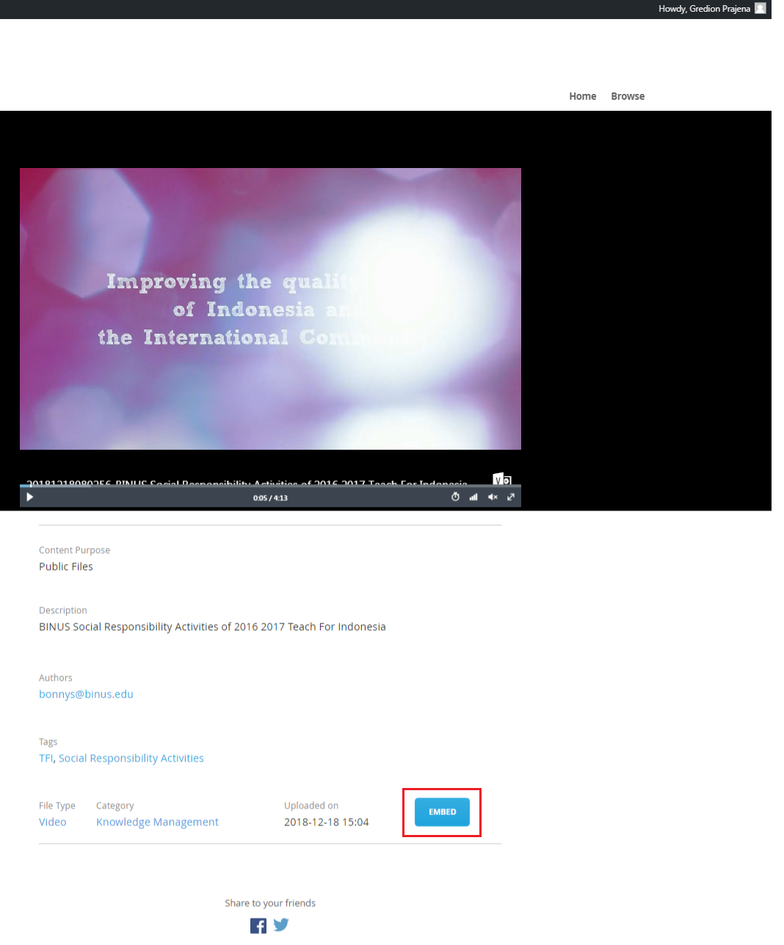
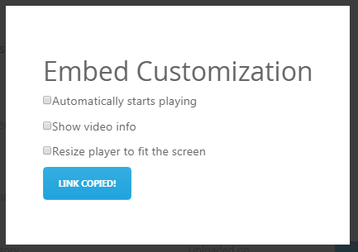
Embed Video
To embed video you can get link to embed by click EMBED button on video file and COPY URL.
<iframe width=800 height=600 style="margin:auto; display:block;border:solid 1px black"
src="https://binusianorg.sharepoint.com/portals/hub/_layouts/15/VideoEm
bedHost.aspx?chId=a197c257-00a8-449d-89bf-bd8a33b2d87d&vId=b11ed1
be-119a-4d6b-9275-a46032741fca&width=800&height=600&autoPlay=false&show
Info=true" allowfullscreen></iframe>

Slide 21
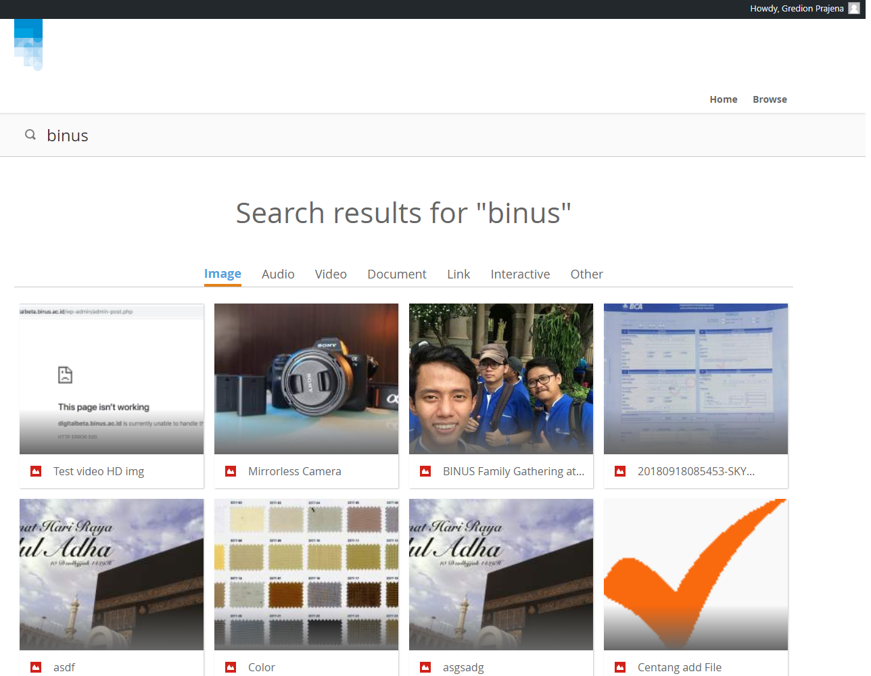
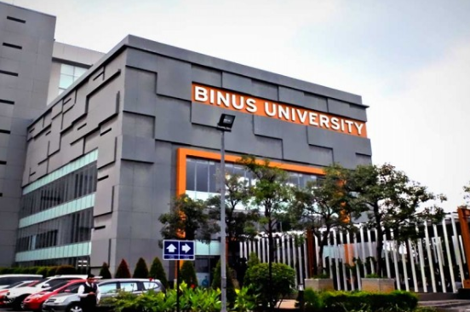
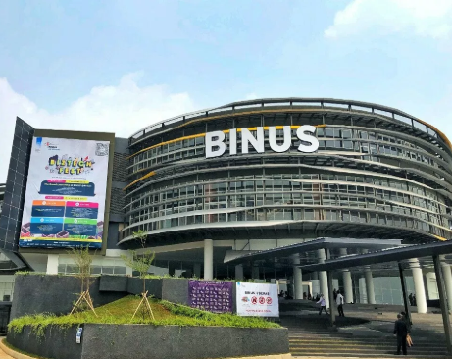
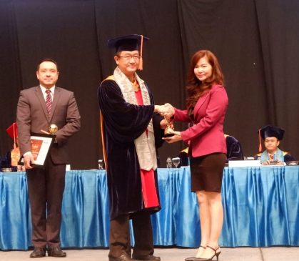
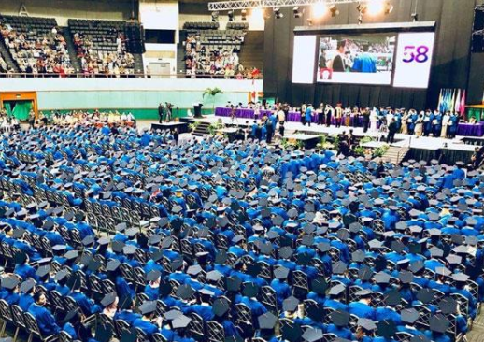
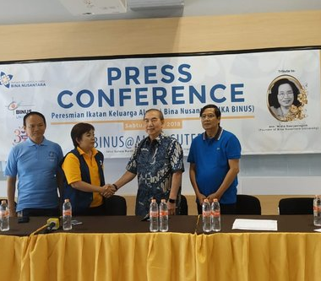
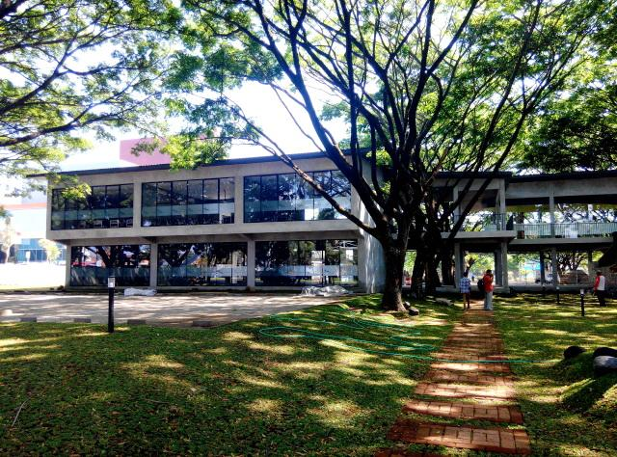
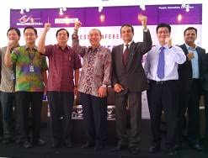

Search
On home page, type keyword you want to search and enter.
It will show search result.
Binus Kampus Anggrek
Binus Bekasi Keren
Binus MNC terima Peng…
Binus Wisuda 2,443…
Press Conference
Binus @Malang
Binus @Malang
Apapun alasannya…

Slide 22
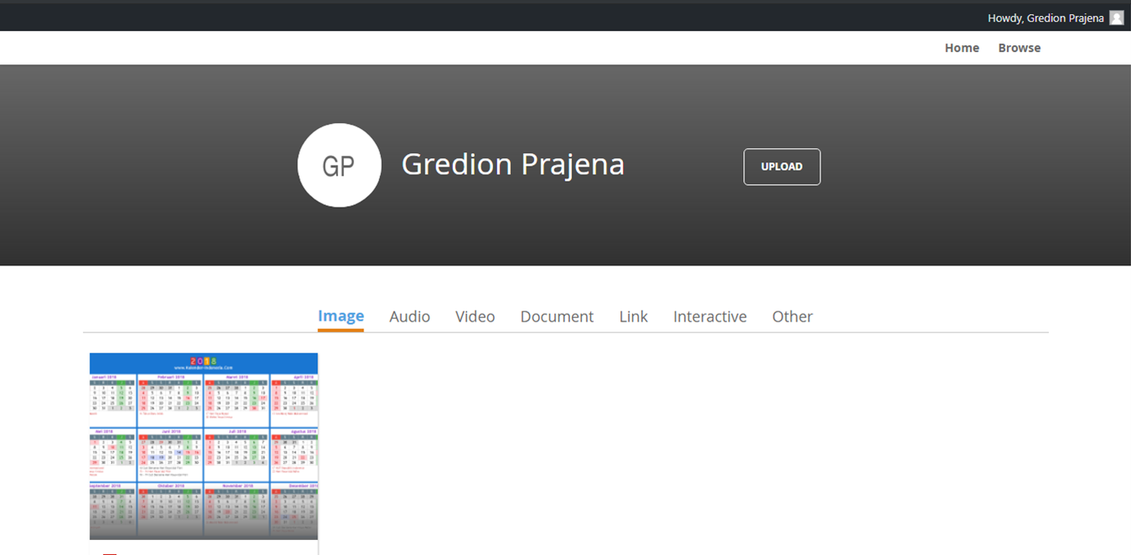
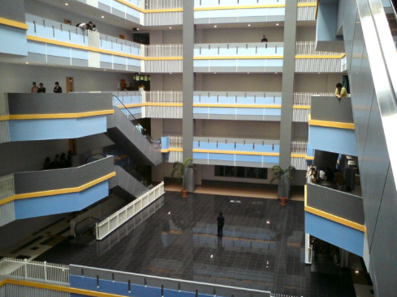
Profile
To open your profile click your name on top right corner, and it will show your uploaded files.

Slide 23
Thank you Q & A

Slide 24
Appendix
Binus DAMS Technology
Binus DAMS Architecture
Road show Binus DAMS

Slide 25




Binus DAMS Technology
Azure Active Directory
Microsoft Stream

Slide 26
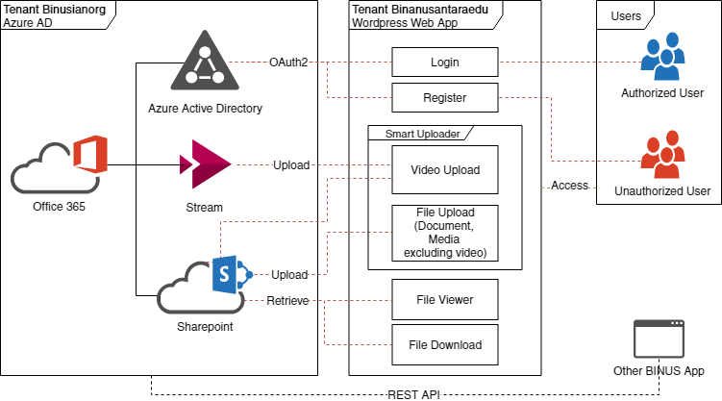
Binus DAMS Architecture

Slide 27
Road show Binus DAMS
No. | Audience | Date – time | Room | Speaker
1 | Binus TV | 28 Aug 2018 13.30 | Syahdan, Binus TV | Karto, Gredion
2 | Lecturer | 13 Feb 2019 14.30 | Alam Sutera A1407 | Karto
3 | Lecturer | 26 Feb 2019 16.30 | Anggrek Lab 710 | Gredion

